Slide 1
Propositional Logic
and Resolution
Dave Touretzky
Read Sections 7.1 - 7.5 of Russell & Norvig

Slide 2
The Big Picture
General Search:
states are arbitrary
CSPs
structured states: vars ∊ domains
constraint propagation
Constraint Manipulation:
cycle cutset; tree decomposition
Satisfiability:
variables ∊ {true, false}
constraints = logical formulae
Constraint Manipulation:
resolution theorem proving

Slide 3
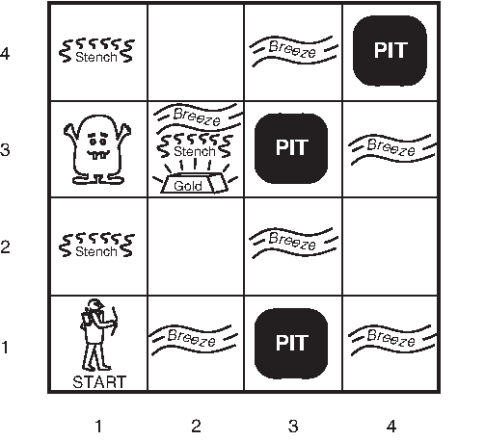
Logical Reasoning as CSP
Find variable assignments (“models”) that satisfy all constraints.
Wumpus World
B_{ij} = breeze felt
S_{ij} = stench smelt
P_{ij} = pit here
W_{ij} = wumpus here
G = gold

Slide 4
Constraint Language: Syntax
Sentence: atomic or complex
Atomic sentence: P, Q, R, …, True, False
Complex sentence:
  (Sentence) | [Sentence]
  ¬ Sentence “negation”
  Sentence ∧ Sentence “conjunction”
  Sentence ∨ Sentence “disjunction”
  Sentence ⇒ Sentence “implies” / “if-then”
  Sentence ⇔ Sentence “biconditional” / “iff”

Slide 5
Notes on Connectives
𝛂 ∨ 𝛃 is inclusive or, not exclusive
𝛂 ⇒ 𝛃 is equivalent to ¬𝛂 ∨ 𝛃
  Says who?
𝛂 ⇔ 𝛃 is equivalent to (𝛂 ⇒ 𝛃) ∧ (𝛃 ⇒ 𝛂)
  Prove it!

Slide 6
𝛂 ⇒ 𝛃 is equivalent to ¬𝛂 ∨ 𝛃
𝛂 | 𝛃 | 𝛂 ⇒ 𝛃 | ¬𝛂 | ¬𝛂 ∨ 𝛃
F | F | T | T | T
F | T | T | T | T
T | F | F | F | F
T | T | T | F | T
When two expressions produce the same result in all possible models, their equivalence is a tautology.

Slide 7
𝛂 ⇔ 𝛃 is equivalent to (𝛂 ⇒ 𝛃) ∧ (𝛃 ⇒ 𝛂)
𝛂 | 𝛃 | 𝛂 ⇔ 𝛃 | 𝛂 ⇒ 𝛃 | 𝛃 ⇒ 𝛂 | (𝛂⇒𝛃) ∧ (𝛃⇒𝛂)
F | F | T | T | T | T
F | T | F | T | F | F
T | F | F | F | T | F
T | T | T | T | T | T
The equivalence is a tautology because it’s true in all models. Expressed as a logical sentence:
(𝛂 ⇔ 𝛃) ⇔ [(𝛂 ⇒ 𝛃) ∧ (𝛃 ⇒ 𝛂)]

Slide 8
Literals
Positive literal: P
Negative literal: ¬ P
Literals represent simple claims about the world.
Literal sentences are unary constraints on the model.
Literal (Unary Constraint) | Model
P | P = True
¬ P | P = False

Slide 9
Sentences As Constraints
A sentence with n variables functions as an n-ary constraint on possible models:
[(p ∧ ¬q) ∨ (q ∧ ¬p)] ⇒ r
P | Q | R
false | false | false
false | false | true
false | true | false
false | true | true
true | false | false
true | false | true
true | true | false
true | true | true
Possible
Models

Slide 10
Semantics: Entailment
𝛂 ⊨ 𝛃 if and only if, in every model in which 𝛂 is true, 𝛃 is also true.
M(𝛂) denotes the set of all models of 𝛂.
𝛂 ⊨ 𝛃 means M(𝛂) ⊆ M(𝛃)

Slide 11
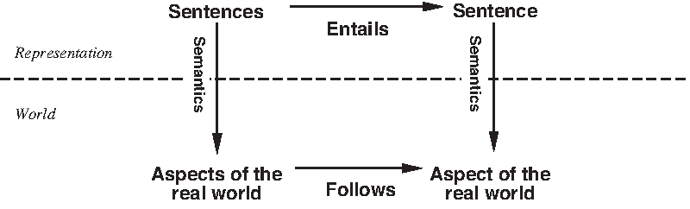
Semantics: Grounding

Slide 12
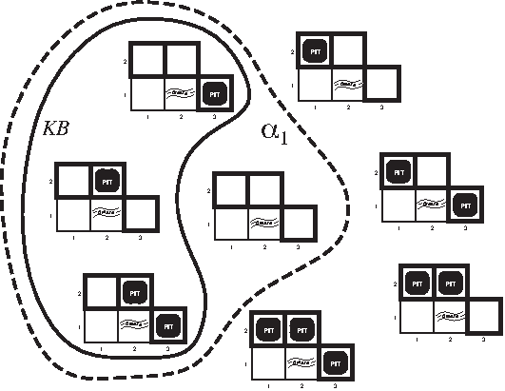
Inference By Model Checking
𝛂₁is models with no pit at 1,2.
𝛂₁ = M(¬P_{1,2})
At 1,1: nothing.
¬P_{1,1} , ¬B_{1,1}
At 2,1: breeze
B_{2,1} , ¬P_{2,1}
Constraints:
P_{2,1}⇒ B_{1,1}∧B_{2,2}∧ B_{3,1}
B_{2,1}⇔ P_{1,1}∨ P_{2,2} ∨P_{3,1}
KB
All models consistent with KB and constraints.
M(KB) ⊆ M(𝛂₁) so KB ⊧ 𝛂₁. Conclude ¬ P_{1,2}.

Slide 13
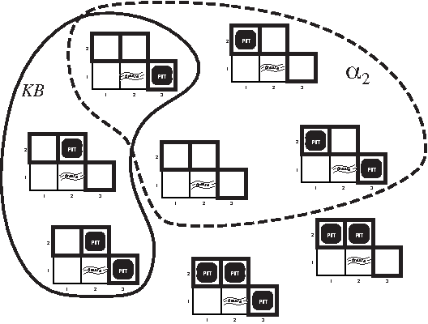
Inference By Model Checking
𝛂₂is models with no pit at 2,2
𝛂₂ = M(¬P_{2,2})
At 1,1: nothing.
¬P_{1,1} , ¬B_{1,1}
At 2,1: breeze
B_{2,1} , ¬P_{2,1}
Constraints:
P_{2,1}⇒ B_{1,1}∧B_{2,2}∧ B_{3,1}
B_{2,1}⇔ P_{1,1}∨ P_{2,2} ∨P_{3,1}
KB
All models consistent with KB and constraints.
M(KB) ⊈ M(𝛂₂) so KB ⊭ 𝛂₂. Can’t conclude ¬ P_{2,2}.

Slide 14
Wumpus World Agent
Step | Agent Action | Tell KB (variable assignment)
1 | Start at 1,1. Sense: nothing. | ¬ P_{1,1} , ¬ B_{1,1}
 | Model check. Relevant constraints: P_{2,1} ⇒ B₁₁ , P_{1,2} ⇒ B₁₁ Constraint is false in any model with P_{2,1}. So KB ⊧ ¬ P_{2,1}. Similarly, KB ⊧ ¬ P_{1,2}. | ¬ P_{2,1} , ¬ P_{1,2}
2 | Agent moves to 2,1. Sense: breeze. | B_{2,1}
 | Model check. Relevant constraints: B_{2,1} ⊧ P_{1,1} ∨ P_{2,2} ∨ P_{3,1} There could be a pit at 2,2 or 3,1 or both. Can’t infer any new literals. | --

Slide 15
Wumpus World Agent
Step | Agent Action | Tell KB (variable assignment)
3 | Agent returns to 1,1. | --
4 | Agent moves to 1,2. Sense stench, no breeze. | ¬ B_{1,2}
 | Model check. Relevant constraints: P_{2,2} ⇒ B₁₂ , P_{1,3} ⇒ B₁₂ Constraint is false in any model with P_{2,2}. So KB ⊧ ¬ P_{2,2}. Similarly, KB ⊧ ¬ P_{1,3}. Another relevant constraint: B_{1,2} ⇔ (P_{1,1} ∨ P_{2,2} ∨ P_{3,1}) Constraint propagation gives: P_{3,1}. | ¬ P_{2,2} , ¬ P_{1,3} P_{3,1}

Slide 16
Cost of Model Checking Inference
A 4x4 wumpus world has 16 squares.
Four variables per square: P_{ij}, B_{ij}, S_{ij}, W_{ij}
  There are 64 variables.
Search space is 2⁶⁴ possible models!
  This could take a while…
What can we do?

Slide 17
Option 1: Exploit Locality
A constraint only references a square and its four neighbors.
  Solve subproblems for smaller regions.
  Share variable assignments across subproblems to get a global solution.
Constraints on P/B don’t mention S or W.
Constraints on S/W don’t mention P or B.
  Separate the P/B and S/W models.
  Reduces state space from 2^{n} to 2×2^{n/2}.

Slide 18
Option 2: Go Meta
Instead of searching the space of models, let’s search the space of constraints (logical formulae).
Adopt inference rules to derive new formulae from old.
  This is called theorem proving.
Deriving new literals will directly give us valid models.

Slide 19
Inference Rule 1: Modus Ponens
Latin for “mode that affirms”.
𝛂 ⇒ 𝛃 , 𝛂
____________________
𝛃

Slide 20
Inference Rule 2: And-Elimination
𝛂 ∧ 𝛃
_______________
𝛂

Slide 21
Inference Rule 3: And-Introduction
𝛂 , 𝛃
_______________
𝛂 ∧ 𝛃

Slide 22
Inference Rules Resulting From Logical Equivalences (1/4)
Commutativity:
(𝛂 ∧ 𝛃) ≡ (𝛃 ∧ 𝛂)
(𝛂 ∨ 𝛃) ≡ (𝛃 ∨ 𝛂)
Associativity:
((𝛂 ∧ 𝛃) ∧ 𝛄) ≡ (𝛂 ∧ (𝛃 ∧ 𝛄))
((𝛂 ∨ 𝛃) ∨ 𝛄) ≡ (𝛂 ∨ (𝛃 ∨ 𝛄))

Slide 23
Inference Rules Resulting From Logical Equivalences (2/4)
Double-negation elimination:
¬(¬𝛂) ≡ 𝛂
Contraposition:
(𝛂 ⇒ 𝛃) ≡ (¬𝛃 ⇒ ¬𝛂)

Slide 24
Inference Rules Resulting From Logical Equivalences (3/4)
Implication elimination:
(𝛂 ⇒ 𝛃) ≡ (¬𝛂 ∨ 𝛃)
Biconditional elimination:
(𝛂 ⇔ 𝛃) ≡ ((𝛂 ⇒ 𝛃) ∧ (𝛃 ⇒ 𝛂))

Slide 25
Inference Rules Resulting From Logical Equivalences (4/4)
De Morgan’s Laws:
¬ (𝛂 ∧ 𝛃) ≡ (¬𝛂 ∨ ¬𝛃)
¬ (𝛂 ∨ 𝛃) ≡ (¬𝛂 ∧ ¬𝛃)
Distributivity:
(𝛂 ∧ (𝛃 ∨ 𝛄)) ≡ ((𝛂 ∧ 𝛃) ∨ (𝛂 ∧ 𝛄))
(𝛂 ∨ (𝛃 ∧ 𝛄)) ≡ ((𝛂 ∨ 𝛃) ∧ (𝛂 ∨ 𝛄))

Slide 26
Proof: From ¬B_{1,1} Derive ¬P_{2,1}
1 | ¬ B_{1,1} | Given
2 | B_{1,1} ⇔ (P_{1,2} ∨ P_{2,1}) | Wumpus constraint (given)
3 | (B_{1,1} ⇒ (P_{1,2} ∨ P_{2,1})) ∧ ((P_{1,2} ∨ P_{2,1}) ⇒ B_{1,1}) | Biconditional elimination from 2
4 | (P_{1,2} ∨ P_{2,1}) ⇒ B_{1,1} | And-Elimination from 3
5 | ¬B_{1,1} ⇒ ¬(P_{1,2} ∨ P_{2,1}) | Contrapositive from 4
6 | ¬ (P_{1,2} ∨ P_{2,1}) | Modus ponens from 1 + 5
7 | (¬P_{1,2} ∧ ¬P_{2,1}) | De Morgan from 6
8 | ¬P_{2,1} | And-Elimination from 7

Slide 27
Soundness and Completeness
Entailment: 𝛂 ⊧ 𝛃 means 𝛃 is true in all models of 𝛂.
Derivation: 𝛂 ⊦_{I} 𝛃 means 𝛃 can be derived from 𝛂 using the inference rules in I.
Soundness of I: if 𝛂 ⊦_{I} 𝛃 then 𝛂 ⊧ 𝛃
  Using I, we only derive entailed sentences.
  “We don’t make stuff up.”
Completeness of I: if 𝛂 ⊧ 𝛃 then 𝛂 ⊦_{I} 𝛃
  All entailed sentences are derivable using I.
  “If it’s true, we can deduce it.”

Slide 28
Validity and Satisfiability
A sentence 𝛂 is valid if it is true in all models. We denote this by ⊧𝛂.
A sentence 𝛂 is satisfiable if it is true in at least one model.
If a sentence 𝛂 is valid, its negation ¬𝛂 is not satisfiable.
  To prove 𝛂, show that ¬𝛂 is unsatisfiable.

Slide 29
Theorem Proving
Start with axioms and givens, and apply inference rules to derive new formulae.
But there are O(2^{N}) formulae in N vars!
And most are useless.
How can we focus on formulae relevant to proving our goal?

Slide 30
Resolution Theorem Proving
The good news: there is a single inference rule that is sound, complete, and can find proofs with reasonable efficiency.
The bad news: it only works for problems in conjunctive normal form.
But any sentence can be rewritten in conjunctive normal form.
… but length may increase exponentially.

Slide 31
Definition: Clause
A clause is a disjunction of literals:
l₁ ∨ l₂ ∨ … ∨ l_{n}
The l_{i} may be positive or negative.
A single literal l is called a unit clause.

Slide 32
Definition: Conjunctive Normal Form
A sentence is in conjunctive normal form if it is a conjunction of clauses:
c₁ ∧ c₂ ∧ … ∧ c_{m}
Example:
(P ∨ ¬Q ∨ R) ∧ (Q ∨ S) ∧ (P ∨ ¬R ∨ T)

Slide 33
Converting to CNF
B_{1,1} ⇔ (P_{1,2} ∨ P_{2,1}) | Given
(B_{1,1} ⇒ (P_{1,2} ∨ P_{2,1})) ∧ ((P_{1,2} ∨ P_{2,1}) ⇒ B_{1,1}) | Biconditional elimination
(¬B_{1,1} ∨ P_{1,2} ∨ P_{2,1}) ∧ (¬(P_{1,2} ∨ P_{2,1}) ∨ B_{1,1}) | Implication elimination (twice)
(¬B_{1,1} ∨ P_{1,2} ∨ P_{2,1}) ∧ ((¬P_{1,2} ∧ ¬P_{2,1}) ∨ B_{1,1}) | De Morgan
[ (¬B_{1,1} ∨ P_{1,2} ∨ P_{2,1}) ∧ (¬P_{1,2} ∨ B_{1,1} ) ∧ (¬P_{2,1} ∨ B_{1,1}) ] | Distributivity Result is in CNF.

Slide 34
Converting to CNF
(a ∧ b) ∨ (c ∧ d) ∨ (e ∧ f)
converts to
(a ∨ c ∨ e) ∧ (a ∨ c ∨ f) ∧
(a ∨ d ∨ e) ∧ (a ∨ d ∨ f) ∧
(b ∨ c ∨ e) ∧ (b ∨ c ∨ f) ∧
(b ∨ d ∨ e) ∧ (b ∨ d ∨ f) ∧
This sentence happens to be in DNF.

Slide 35
The Resolution Inference Rule
l₁ ∨ l₂ ∨ … ∨ l_{k} , m₁ ∨ m₂ ∨ … ∨ m_{n}
________________________________________________________
l₁ ∨ … ∨ l_{i-1} ∨ l_{i+1} ∨ … ∨ l_{k} ∨
m₁ ∨ … ∨ m_{j-1} ∨ m_{j+1} ∨ … ∨ m_{n}
where l_{i} and m_{j} are complementary literals,
i.e., l_{i} is ¬m_{j}.
From two clauses of length k and n, derives a new clause of length k+n-2.

Slide 36
Resolution Example
P_{1,1} ∨ P_{2,2} ∨ P_{3,1} , ¬P_{2,2}
________________________________________
P_{1,1} ∨ P_{3,1}

Slide 37
Contradictions Generate
An Empty Clause
P ∧ ¬P is a contradiction, and therefore unsatisfiable.
Resolving P with ¬P yields an empty clause.
P , ¬P
_____________________
⃞

Slide 38
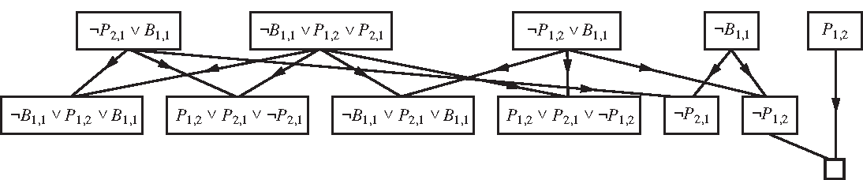
Wumpus Reasoning by Resolution
Not a horn clause
Tautology (useless)
To prove ¬P_{1,2}, add P_{1,2} to the set of givens and use resolution to derive a contradiction.

Slide 39
More Efficient Inference
Resolution is complete, but even with only one inference rule, the worst case cost is exponential in the # of symbols.
But for problems that can be formulated using Horn clauses, inference can be more efficient.
With definite clauses entailment can be decided in linear time.

Slide 40
Horn Clauses
A Horn clause is a clause with at most one positive literal.
A definite clause has exactly one.
  Example: (¬q₁ ∨ ¬q₂ ∨ … ∨ ¬q_{n} ∨ p)
The positive literal p is called the head.
A definite clause is equivalent to:
(q₁ ∧ q₂ ∧ … ∧ q_{n}) ⇒ p

Slide 41
Reasoning With Horn Clauses
Clauses consisting of a single positive literal are called facts.
A clause with no positive literals is called a goal.
Horn clauses are closed under resolution.

Slide 42
Forward Chaining Algorithm
Requires the KB to consist of definite clauses (exactly one positive literal):
  Facts: q₁, q₂, …
  Rules: (¬q₁ ∨ ¬q₂ ∨ … ∨ ¬q_{n} ∨ p)
Produces only positive conclusions.
Generates conclusions until goal is reached.
Runs in linear time.

Slide 43
Backward Chaining Algorithm
KB must contain only definite clauses.
  Start with a goal query q.
  Find the rules whose conclusion is q.
  Try to recursively prove the antecedents of each rule.
Only looks at facts relevant to the query q.
Runs in linear time; is often very fast.

Slide 44
Summary
Propositional logic is a constraint language.
Model checking can be tractable if you can exploit locality in the state space.
Propositional entailment is co-NP Complete, so worst case is O(2^{N}).
In practice, many problems can be solved efficiently by resolution, especially if they can be formulated using definite clauses.

